Slide 1




MEDIGUIDE
Personalized Healthcare Assistant
By Himanshu Nagapure

Slide 2
TABLE OF CONTENTS
Introduction
Project Objective
Project Summary
Methodology & Process
Web Interface
Results & Insights
Conclusion

Slide 3
INTRODUCTION
MediGuide is a data-driven personalized healthcare recommendation system designed to assist users in managing their health by providing customized medications, diet plans, workouts, and precautions based on their symptoms. By leveraging machine learning and structured data, MediGuide ensures accurate, reliable, and user-friendly health insights.
OBJECTIVE
The primary goal of MediGuide is to empower individuals with data driven health recommendations that are tailored to their symptoms. The system bridges the gap between general medical knowledge and personalized healthcare by offering real-time, data-driven suggestions.

Slide 4
SUMMARY
MediGuide collects and analyzes health-related data from users to generate customized recommendations. Data in this project is downloaded from Kaggle. The system processes symptoms, cross-references with historical medical data, and provides:
Disease Prediction based on data.
Precautionary measures to prevent worsening conditions.
Suitable medications based on general prescriptions.
Dietary recommendations to enhance recovery and boost immunity.
Workout plans tailored for maintaining a healthy lifestyle.
⚠️ Disclaimer: MediGuide is not a replacement for professional medical advice. Always consult a healthcare provider for a proper diagnosis.

Slide 5
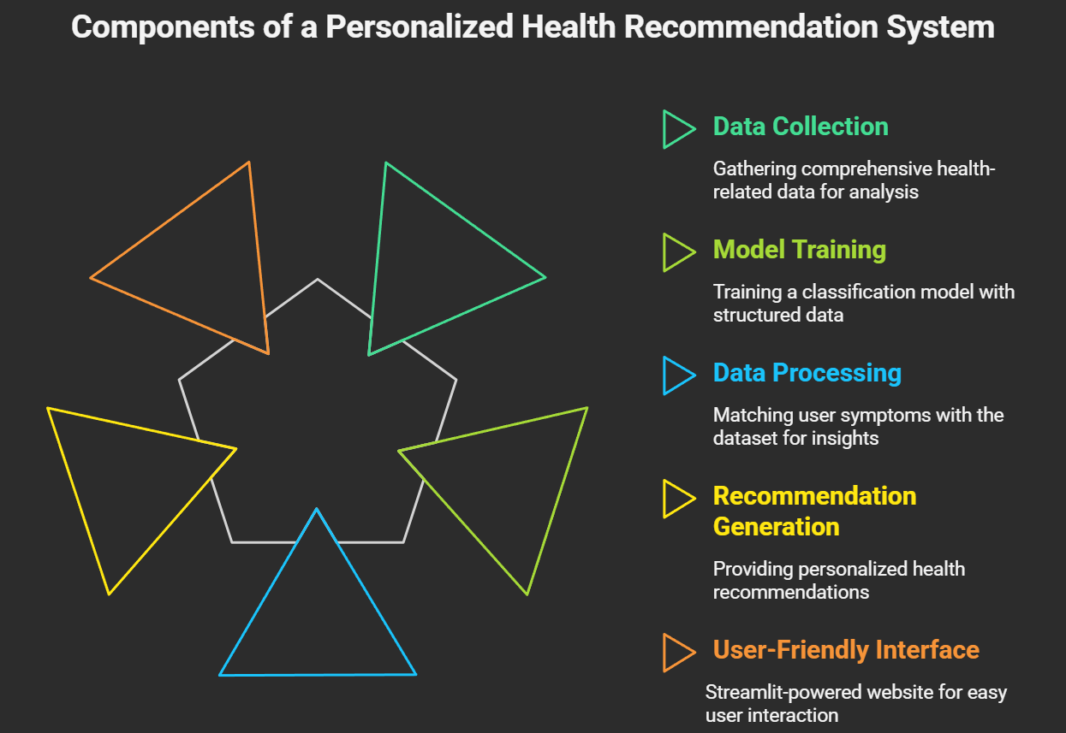
Methodology & Process

Slide 6
Methodology & Process
The development of MediGuide followed a structured, data-driven approach:
1. Data Collection & Preprocessing
Medical datasets were sourced from Kaggle, cleaned, and structured into CSV files.
A dataset containing symptoms, medication details, diet plans, precautions, and workout routines is used.
2. Machine Learning Model Development
Applied Supervised Learning Algorithms: Support Vector Machine (SVM) for multi-class disease classification.
Training Dataset: Contained symptom-disease relationships with historical data.
Model Evaluation: Used precision, recall, and F1-score to assess performance.
3. Data Processing
User-input symptoms are matched with the dataset.
4. Recommendation System Development
Medications – Linked disease predictions with suitable medical treatments.
Diet Plans – Suggested nutrient-rich foods for faster recovery.
Workout Plans – Designed exercise routines based on health conditions.
Precautions – Displayed necessary preventive measures.
5. User Interface Development
Used Streamlit to create a simple and intuitive UI.
Allowed users to enter symptoms and get instant results.

Slide 7
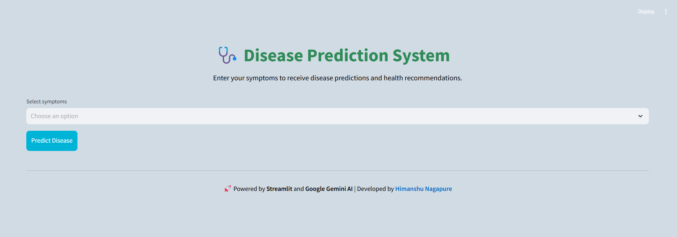
WEB INTERFACE
20XX
HOME SCREEN

Slide 8
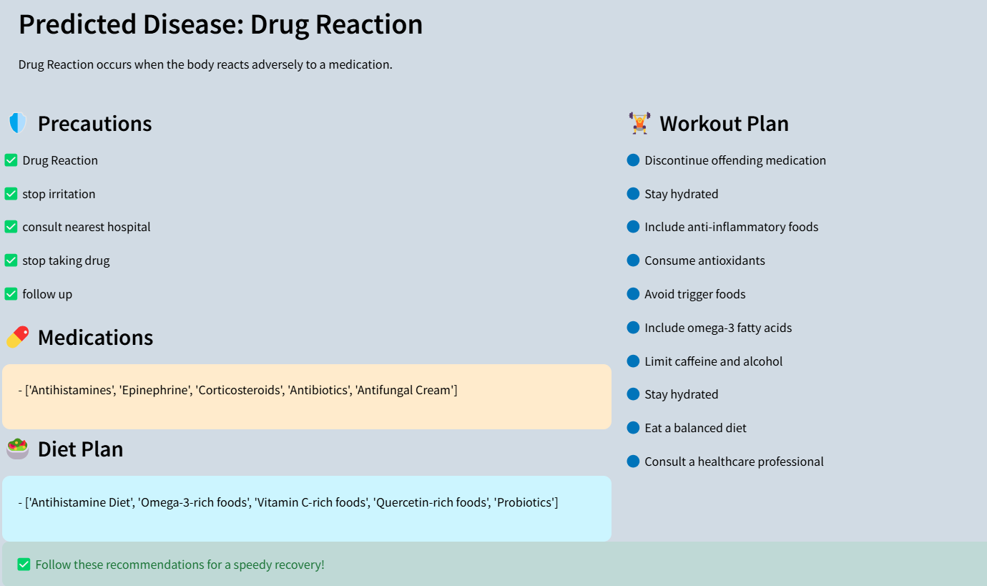
WEB INTERFACE
20XX
DISEASE PREDICTION SCREEN

Slide 9
Results & Insights
Findings & Insights
Results & Benefits
Users find it difficult to obtain quick, customized healthcare suggestions without consulting a professional.
Structured data helps improve recommendation accuracy by mapping symptoms with relevant treatments.
Machine learning-based predictions reduce uncertainty in health management, leading to better preventive care.
A simple, interactive interface encourages engagement, making it easier for users to follow suggested plans.
For Users:
✅ Quick and reliable health recommendations without waiting for medical consultation. ✅ Easy-to-follow precautions, medications, diet, and workout plans. ✅ Accessible on any device via a user-friendly web interface.
For Businesses & Healthcare Providers:
🔹 Reduces patient overload by offering data-drive preliminary diagnosis.

Slide 10
CONCLUSION
MediGuide successfully provides personalized healthcare recommendations using Machine Learning and structured data. The project proves that data-driven health insights can make medical guidance more accessible, faster, and personalized. With future enhancements, MediGuide aims to revolutionize digital healthcare and offer even greater value to users worldwide.

Slide 11
THANK YOU!
By Himanshu Nagapure

